Slide 1


Predicting AFL Winners
By Alexander Lee

Slide 2
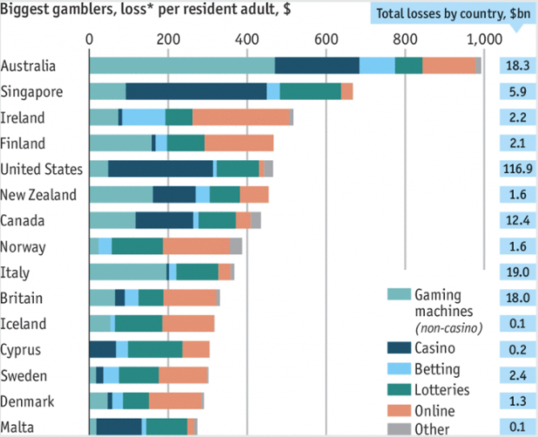
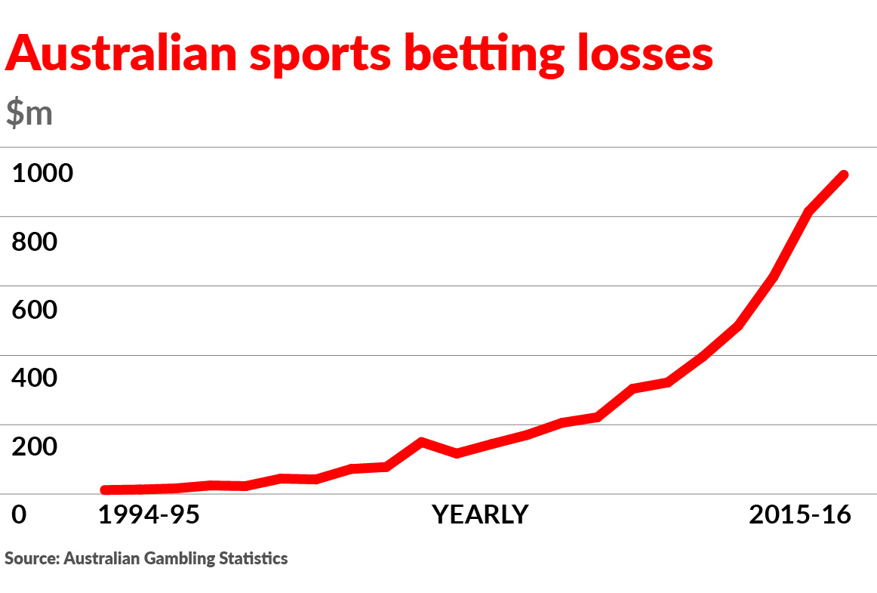
Sports Betting

Slide 3
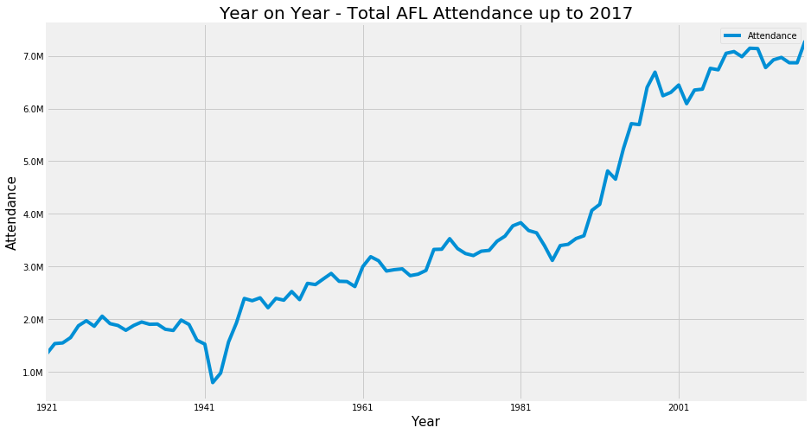
Sports Betting

Slide 4

Creating Features
No strong predictors
Ladder details elsewhere
Stats on current game

Slide 5
Creating Features
Previous Year’s ladder score
Head to Head
Final Series
Teams themselves

Slide 6
The Models:
Logistic Regression
Support Vector Machines (SVM)
Gradient Boosting
Decision Tree
Random Forest
Baseline:
55.92%
Notes:
Specifically left out KNN due to its inability to produce predicted probabilities

Slide 7
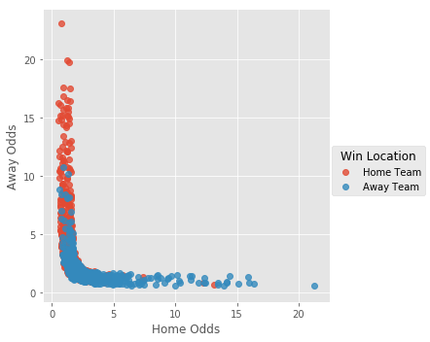
The Models:
Logistic Regression
Support Vector Machines (SVM)
Gradient Boosting
Decision Tree
Random Forest
Notes:
Specifically left out KNN due to its inability to produce predicted probabilities

Slide 8
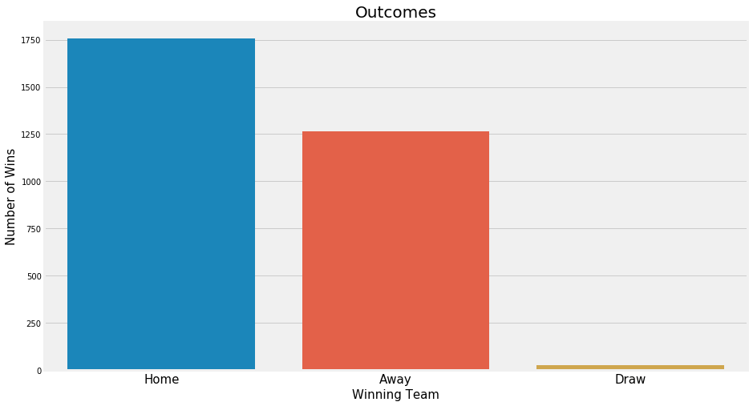
Baseline:

Slide 9
The Models:
Cross Validated
Logistic Regression
Support Vector Machines (SVM)
Gradient Boosting
Decision Tree
Random Forest
Classifier | Accuracy | F1-Score
Logistic Regression | 66.92% | 64.19%
SVM | 62.77% | 69.72%
Gradient Boosting | 57.53% | 62.00%
Decision Tree | 57.91% | 59.66%
Random Forest | 57.86% | 60.14%
Notes:
KNN

Slide 10
The Models:
GridsearchCV
Logistic Regression
Support Vector Machines (SVM)
Gradient Boosting
Decision Tree
Random Forest
Classifier | Accuracy | F1-Score
Logistic Regression | 66.92% | 67.00%
SVM | 65.79% | 66.00%
Gradient Boosting | 66.17% | 66.00%
Decision Tree | 60.90% | 61.00%
Random Forest | 60.90% | 61.00%

Slide 11
A 11% increase in accuracy is great. Are we rich yet?

Slide 12

Study:
Rational Decision Making
2016 Experiment by Victor Haghani & Richard Dewey
61 College Students (Finance/Economics Backgrounds)
Biased Coin (60% Heads)
$25 Starting - $250 Cap
300 Bets over 30 minutes

Slide 13

Study:
Rational Decision Making
Results:
3 in 10 people went bust
Average Payout $75
67% of people bet Tails

Slide 14
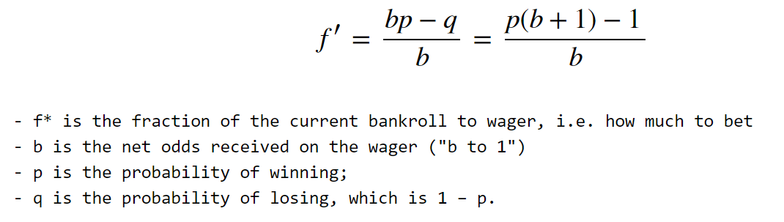
The Kelly Criterion
 |  |  | SportsBet |  | Model
Home Team | Away Team | Winner | Home Odds | Away Odds | Home Prob | Away Prob | Bet % (1/5)
Essendon | Western Bulldogs | Home | 2.31 | 1.59 | 0.49 | 0.51 | 5

Slide 15


Slide 16
Take the results with a grain of salt.

Slide 17
Baseline:
Draw : 0.92%

Slide 18
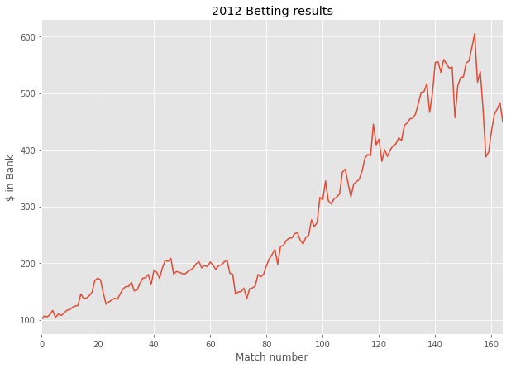
Results

Slide 19
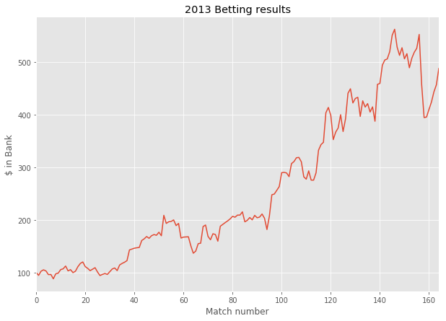
Results

Slide 20
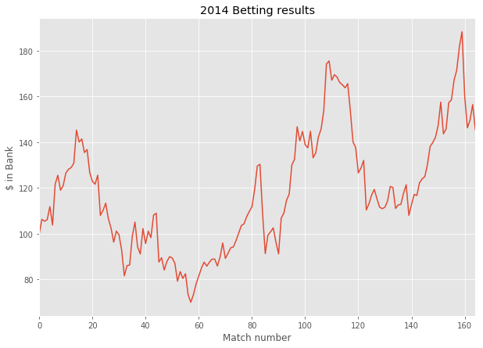
Results

Slide 21
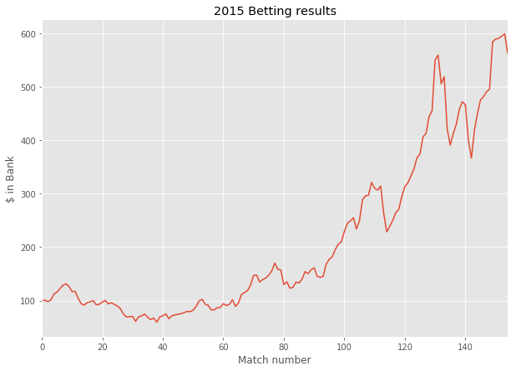
Results

Slide 22
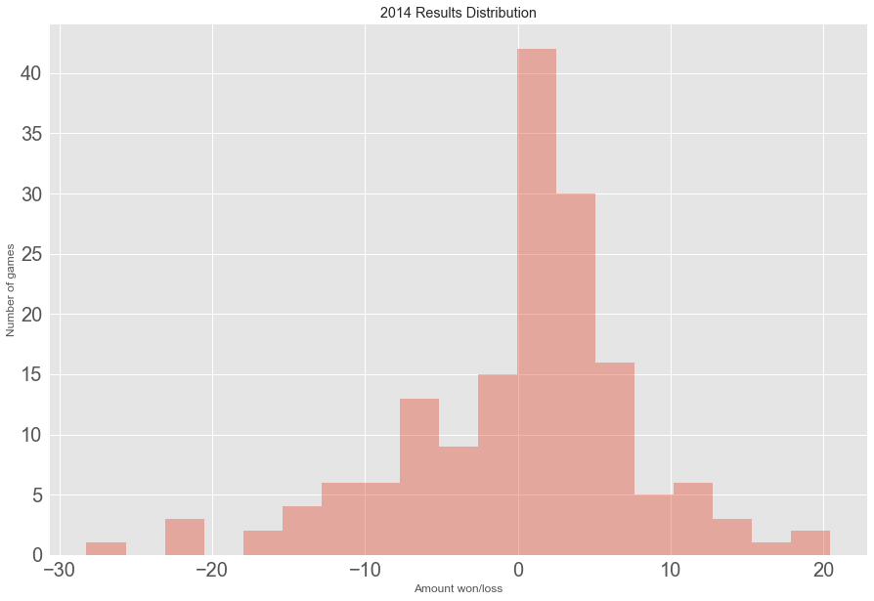
Let’s have a look at 2014

Slide 23
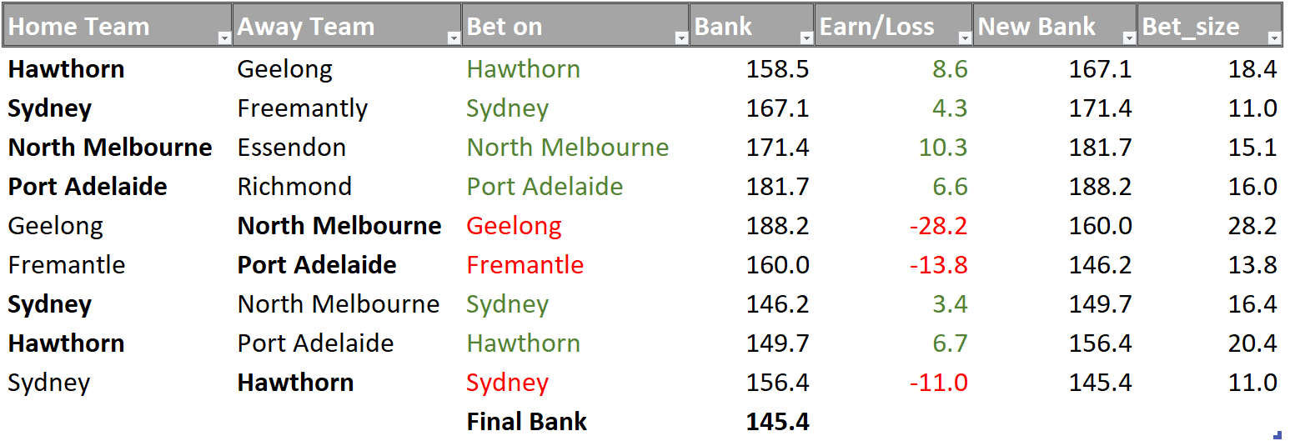
Let’s have a look at 2014
Last 10 Bets of 2014

Slide 24
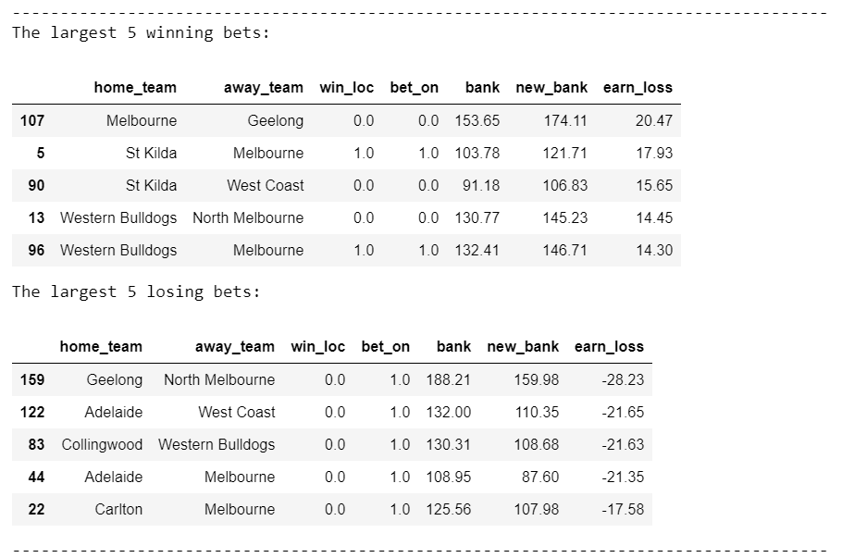
Let’s have a look at 2014

Slide 25
Disclaimers
Past performance is not indicative of future performance.
Gamble Responsibly - Don’t Discriminate

Slide 26
Limitations & Refinements
Adding player details
Draws
Betting on the Margin
2016 & 2017 Data

Slide 27

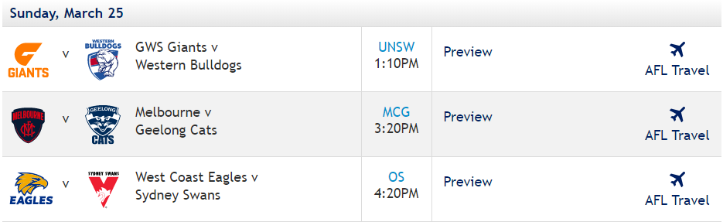
2018
March
25th

